Slide 1


CcpNmr Analysis Version 3
Metabolomics Tutorial
and Practical

Slide 2
Introduction
This document is divided in three sections: part 1 includes general instructions how to get started with CcpnNmr Version3. You should spend only few minutes to complete this section. Part 2 includes instructions how to use Analysis v3 tools for processing and inspecting one dimensional spectra for metabolomics analyses. For the first two sections you will use simulated data downloaded from the BMRB databases. For the final section, you will complete a series of tasks on experimental data using the tools you learned on part 2.
Start CcpNmr Analysis Metabolomics
Apple users by double clicking the file metabolomics inside AnalysisV3/bin
Linux users: on your terminal, cd to AnalysisV3/bin and run ./metabolomics

Slide 3
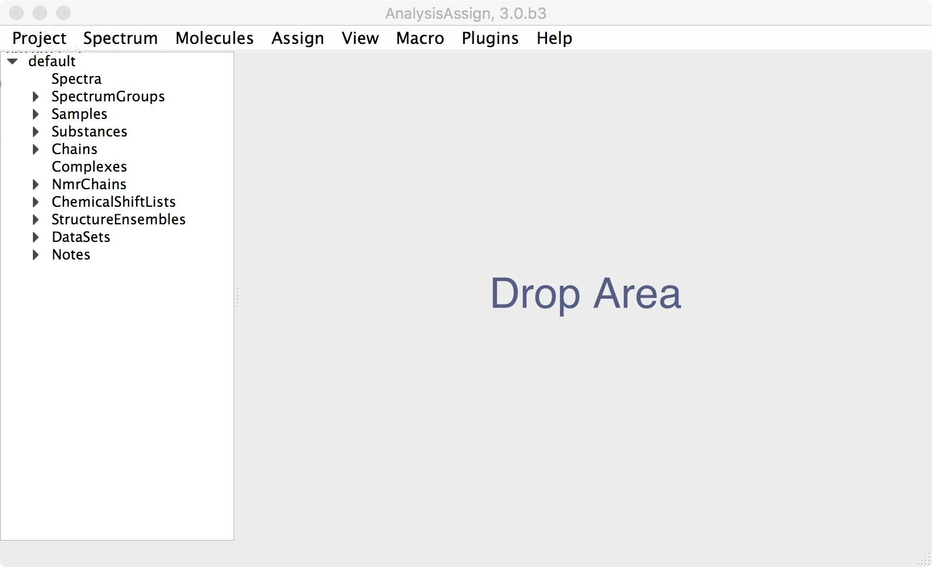
1
Loading spectra
Spectra location : Metabolomics_NMR_Practical/data/SimulatedBMRB
1A
Drag & drop the spectra into the sidebar or drop area.
Find the Acetate on the simulatedBMRB spectra directory (../Metabolomics_NMR_Practical/data/SimulatedBMRB)
select it in finder and drag it onto the sidebar or drop area.
If you drop it on drop area, the spectrum will be displayed immediately, if you drop on sidebar you will need an extra step to display it (1B).
You will also see a arrow appear next to the Spectra label in the sidebar showing that the spectrum has been loaded.
SP:Acetate

Slide 4
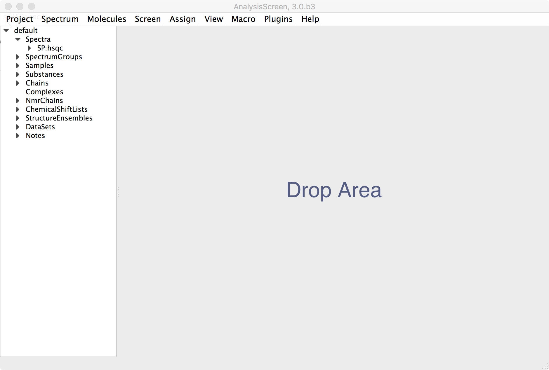
1
Loading spectra
Drag & drop from Sidebar
SP:Acetate
1B
Drag & drop the spectra From the sidebar to the drop area.
Select the spectrum you want to display on sidebar
Drag and drop it to the main drop area
Alternatively:
right click on the sidebar item:
click on open as module
Right Click on Sidebar Item
Acetate

Slide 5
1
Loading spectra
Drag over the purple bar then drop
1C
Display more spectra.
Add a new spectrum to the project (like 1A), for example the Alanine
Select it on sidebar, hold down the left mouse button and start to drag
Drag it to the top bar of the currently displayed spectrum without dropping yet. When a semi-transparent purple box appears, the drop area is ready to accept the drop and you can release the button. If you keep holding you can choose another location where to display the spectrum.
The purple box represents the target location where to open the new module. Keep holding the left click and move at the edges of the target module (left, right, top or bottom) then drop the item to display it.

Slide 6
1
Loading spectra
Drag and drop from sidebar over another spectrum display
1D
Overlay spectra.
Select it on sidebar, hold down the left mouse button and start to drag
Drop it to the middle of the currently displayed spectrum.
Right click on the display, select Stack Spectra; this functionality will help you for analysing multiple overlaid spectra.

Slide 7
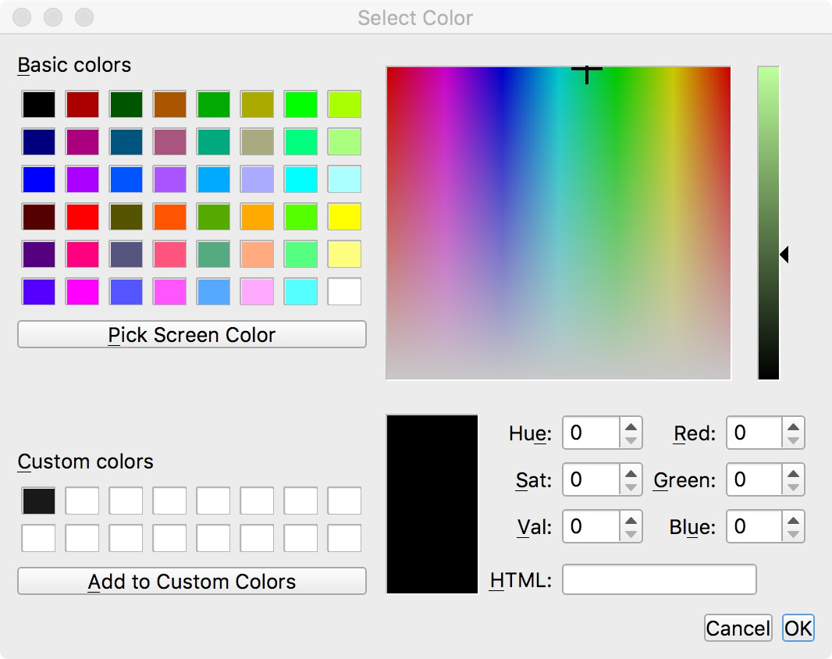
1
Displaying spectra
To Change spectrum parameters and colours:
Double click
1E
Customise colours
To change properties of a spectrum including the contour colours, double click its name in the Sidebar and a dialogue box will popup with a series of tabs in it.
In the first tab, you can set general parameters of the spectrum, such as type, path, name, scaling, spectrum type etc. Changing the values in each box and hitting Apply will change the parameter value.
In the Dimensions tab, you can view information on each dimension of the spectrum and change referencing and assignment tolerances for each dimension.

Slide 8
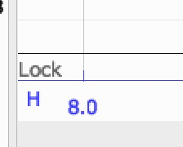
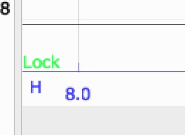
1
Actions
Mouse:
Keyboard:
Pan the spectrum
Zoom box
Zoom In – Out (all axes)
Zoom In – Out (one axis)
1F
Mouse actions
Dragging the left mouse button around a spectrum display will pan the spectrum in the direction of movement and the mouse wheel will zoom the x and y axes simultaneously. If you want to zoom into a specific area, using SHIFT+Right Drag it will cause a yellow box to be drawn on the display, which specifies the zoom region.
You can also “lock” the spectrum aspect ratio by toggling the lock button at the bottom-left part of the display. This will disable the single axis zoom.

Slide 9
1
Actions
Left click to hide/show a spectrum
1G
Keyboard actions
Select a spectrum display by clicking any point, this will set the strip as “current” and will highlight the axis.
Use the keyboard keys “+” and ”-” to zoom in and out
Use the directional keyboard keys to move across the spectrum
Displaying different overlayed spectra:
Click on the toolbar button to hide / show a spectrum. The buttons will change colour from dark grey (spectrum visible on the display, “toggle On”) to light grey (spectrum hidden on the display, “toggle Off”) . Tips:
“Tab-Tab” (press twice ⇥⇥) Displays the next spectrum and hides all others
“Tab-A” : Displays all spectra
“Tab-x” : Reverts displayed spectra

Slide 10
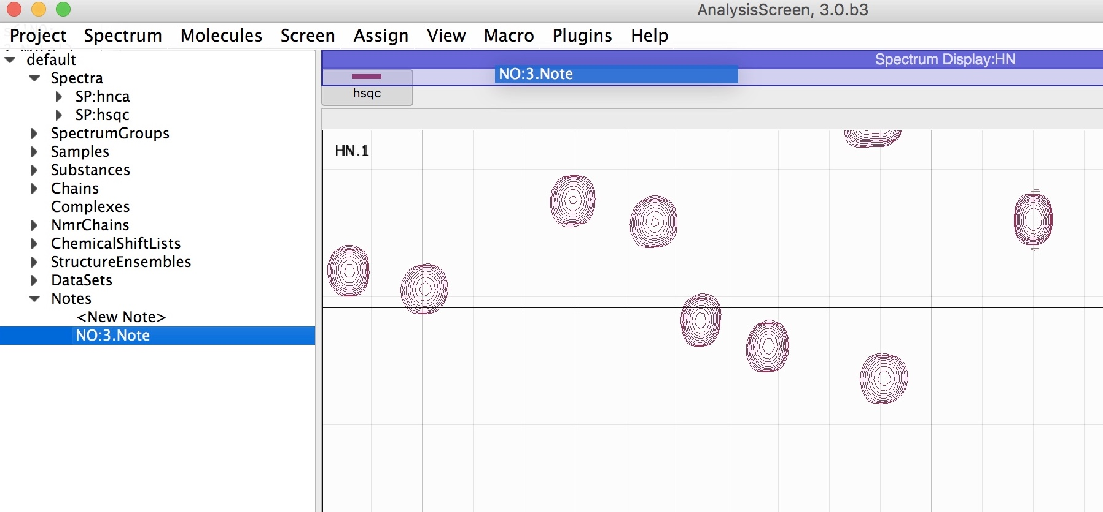
1
Notes
Double Click
Drag and drop over the purple bar
1H
Create a note
It is fundamental to annotate what you do to your spectra. To create a note:
Go on sidebar
click on the note arrow to expand the branch
double click on on <New Note>. This will create a new note
To open it:
Select the new item and drag hovering the top of any existing module and drop it as soon as you see a transparent purple box; alternatively, right click on the sidebar item and select “open as a module”
You can write any text and all changes will be automatically saved on the project.

Slide 11
1
SpectrumGroups
Multiselect Spectra Right Click
1I
Create a SpectrumGroup
Go on sidebar
Select the spectra of interest
right click and select ”Make SpectrumGroup From Selected”
Give a name to the spectrumGroup and press ok.
The new spectrumGroup will appear in sidebar under its branch and can now be visualised as a normal spectrum via drag and drop
Finally, save the project from:
main menu -> Project -> Save as…

Slide 12
2
Processing
Project location : Metabolomics_NMR_Practical/Projects/Simulated
2A
Drag & drop the Project into the sidebar or drop area.
Find the project on the projects directory (../Metabolomics_NMR_Practical/ Projects/Simulated)
Select it in finder and drag it onto the sidebar or drop area.
Drag and drop the spectrumGroup “ref” (References) on the drop area to visualise the group as a single spectrum. This group contains 4 spectra: Acetate, Lactate, Alanine, Isoleucine.
Pan and zoom the display to quickly inspect the spectra. Then close this for the moment.

Slide 13
2
Phasing
2B
Manual Phasing
Expand the SpectrumGroups branch and locate the “SG:PE” and expand it
Drag and drop a spectrum from the SpectrumGroup “SG:PE” to the drop area. E.g. “SP:LactateBE”
Right click inside the spectrum display:
Select ”enter Phasing Console

Slide 14
2
Phasing
2C
Manual Phasing
Set Pivot to 0.0 either using the pivot box or by dragging the dotted pivot line (default position at the middle of the spectrum)
Use the sliders to define the correct phase. For example for this spectrum set ph0 to 5
Press apply to save the changes*
Close the spectrum display.
* Changes are not saved on the disk and the original files are not overwritten

Slide 15
2
Phasing
2D
Automatic Phasing
Automatic phasing or explicit phasing parameters can be applied to multiple spectra at the same time using the built-in pipeline.
Open the pipeline from the main menu:
Main Menu > Metabolomics > Pipeline
Drag and drop the SpectrumGroup “PE” on the input data box of the pipeline
Press Apply
Drag and drop “PE” also on the drop area to visualise the group
Zoom in the H axis to 5-1 ppm (see axis action on 1F) and intensities axis in a region of -1e⁷ and 2e⁷

Slide 16
2
Phasing
Select Phasing Spectra
2E
Automatic Phasing
From the pipeline pulldown: Select Phasing Spectra
Check Automatic, keep all the value as default
Press the green “Play” button to start the pipeline
After few seconds the spectra are automatically phased, you can inspect from the display.

Slide 17
2
Alignment
Select Stack Spectra
2F
Automatic Alignment
Drag and drop the SpectrumGroup “AE” on the input data box of the pipeline
Press Apply
Drag and drop “AE” on the drop area to visualise the group
Right click on the display, select Stack Spectra
Zoom around the 0 ppm region to see the alignment error.
Unstack the spectra

Slide 18
2
Alignment
Left click and drag to adjust limits
Select Align Spectra
2G
Automatic Alignment
Open the pipeline from the main menu:
Main Menu > Metabolomics > Pipeline
Drag and drop the SpectrumGroup “AE” on the input data box of the pipeline
Press Apply
From the pipeline pulldown: Select Align Spectra
Select any spectrum as reference, e.g. SP:acetate
Select the region of the spectrum to use as calibration point, e.g. the DSS peak region within 0.50 to -0.50 ppm
Click the Target button to see graphically the selected region, you can drag the region at any point to adjust the values.
Engines: leave individual as default. This will calculate individual adjustments for each spectrum.
Press the green “Play” button to start the pipeline
After few seconds the spectra are automatically aligned, you can inspect them from the display. Close the pipe

Slide 19
2
Re-referencing
Select Referencing Spectra
-
2H
Re-referencing
As we aligned using the Acetate spectrum as reference, all the spectra now have the DSS peak at a wrong position, probably at -0.2 ppm.
To re-reference these spectra:
On the same pipeline, close the previous pipe
From the pipeline pulldown: Select Referencing Spectra
Origin: set to -0.200 or the peak position you have for the DSS
Target: set to 0 ppm
Press the green “Play” button to start the pipeline

Slide 20
2
PCA
-
2I
Principal component Analysis
Main Menu > Metabolomics > Decomposition (PCA)
On the SpectrumGroups box, select
SG:Ref and SG:BE (ctrl or Cmd for Mac)
Inspect the scatter plot on the right side, you might notice a group of 4 points close to each other at -2.7 on the PC2 axis and other 4 points very spread out.
Open the spectrum group SG:BE (drag and drop on top the PCA module)
Zoom in along the two axes to asses the baseline error issue among the spectra.
You might click any point from the scatter plot to open the correspondent spectrum on a new display.

Slide 21
2
Baseline
Select Baseline correction
2L
Automatic Baseline correction
Open the pipeline from the main menu:
Main Menu > Metabolomics > Pipeline
Drag and drop the SpectrumGroup “BE” on the input data box of the pipeline
Press Apply
From the pipeline pulldown: Select Baseline correction. This pipe doesn’t take any parameters
Press the green “Play” button to start the pipeline
After few seconds the spectra are automatically corrected.
Close the pipeline
reopen the PCA module
Reselect SG:Ref and SG:BE on the spectrumGroups box
Compare the new PCA results to the previous PCA. Has it changed?

Slide 22
3
Practical
Open the project experimental.ccpn and create a new note
Inspect Dataset3; what do you see?
Inspect Dataset2; are these good spectra?
Inspect Dataset1: Do a PCA on this dataset; What do you see? Inspect the dataset for possible problems and use tools explored under 2.0 to improve the spectra quality. Then perform a PCA again. Has the result changed? What do you conclude?
Tips:
Stack spectra to inspect multiple spectra
Open the project experimental2.ccpn
Inspect the first three 2D 13C-HSQCs, open the processing note relative to each spectrum. Which spectrum has been correctly processed?

Slide 23
CcpNmr Analysis Version 3
Contact Us
Website:
www.ccpn.ac.uk
Suggestions and comments:
ccpnmr3@google.com
Issues and bug report:
https://bitbucket.org/ccpnmr/issue-tracker/
Cite Us
Skinner, S. P. et al. CcpNmr AnalysisAssign: a flexible platform for integrated NMR analysis. J. Biomol. NMR (2016). doi:10.1007/s10858-016-0060-y
Practical Version History:
beta3 (LGM & GWV)

